Slide 1
C++ Presentation
欧锋/Ophone/New comer
Feng.Ou@tieto.com

Slide 2
Agenda
Function & Operator Overloading
C++ class/struct
Design a singleton
Inheritation-Derive Class
Virtual function

Slide 3

Function & Operator Overloading
When two or more different declarations are specified for a single name in the same scope, that name is said to be overloaded.(ISO14882, chs 13)

Slide 4
Function & Operator Overloading
C++ allows overloading of all function names and nearly all operators that handle user-defined types.
You may not overload:
the scope resolution operator ::
the member selection (dot) operator .

Slide 5
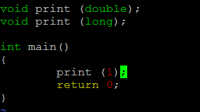
Question#1 for overloading
https://github.com/Morpheusou/TCPL/blob/master/chapter12/12.3.1_1.cpp

Slide 6
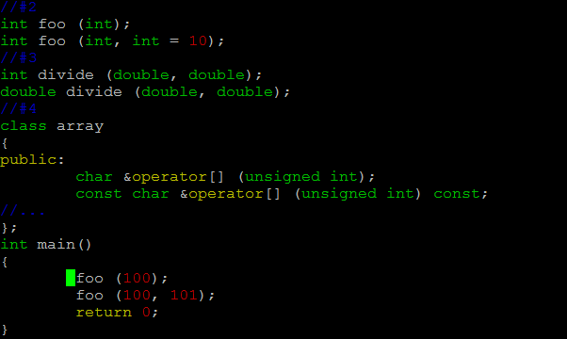
Question#2 for overloading
https://github.com/Morpheusou/TCPL/blob/master/chapter12/ambiguous.cpp

Slide 7
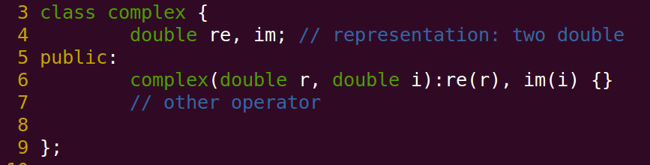
C++ class/struct-definition
[BS] A class is a user-defined type provided to represent a concept in the code of program.
https://github.com/Morpheusou/TCPL/blob/master/demo/class.cpp
Notes:
BS=Bjarne Stroustrup

Slide 8

Puzzle#1 class/struct
https://github.com/Morpheusou/TCPL/blob/master/demo/class.cpp

Slide 9
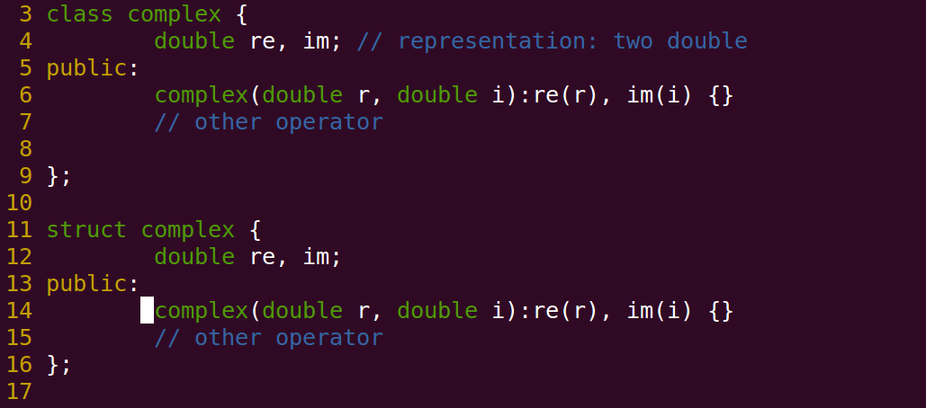
Question#3 class/struct
https://github.com/Morpheusou/TCPL/blob/master/demo/class.cpp

Slide 10
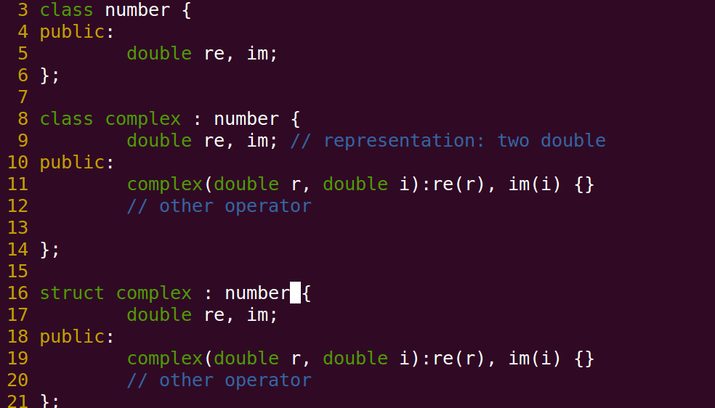
Question#4 class/struct
https://github.com/Morpheusou/TCPL/blob/master/demo/class.cpp

Slide 11
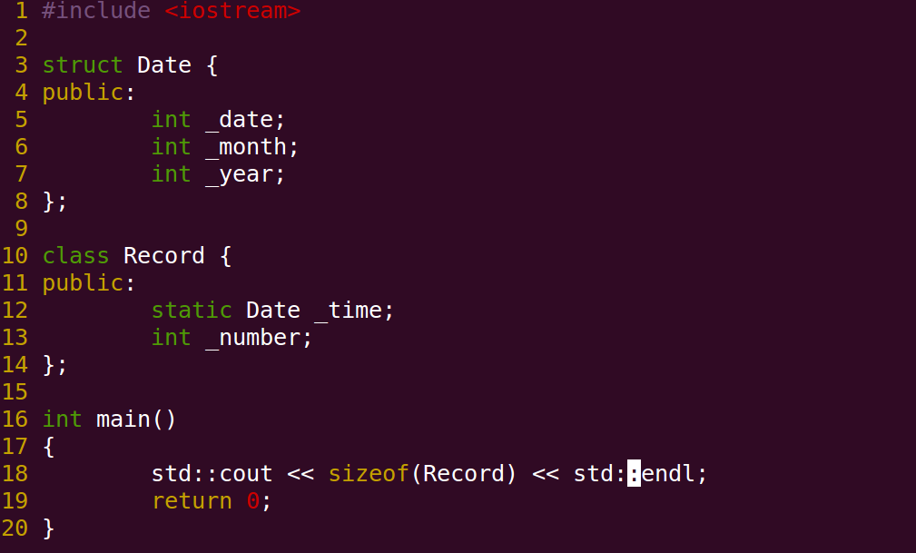
Question#5 static member
https://github.com/Morpheusou/TCPL/blob/master/demo/static.cpp

Slide 12
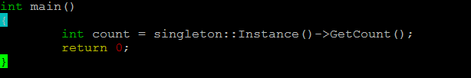
Design a singleton
Ensure a class only has one instance
Provide a global point of access to it
File variable – extern vs static
extern function
https://github.com/Morpheusou/TCPL/blob/master/demo/singleton.cpp

Slide 13
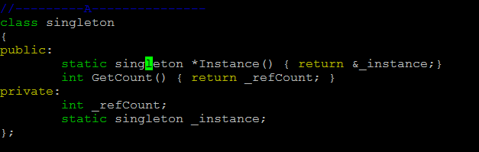
Singleton implementation #A
https://github.com/Morpheusou/TCPL/blob/master/demo/singleton.cpp

Slide 14
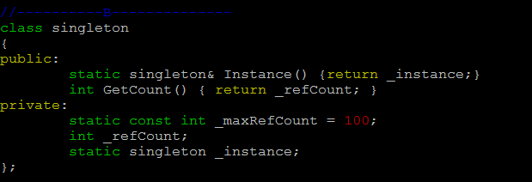
Singleton implementation #B
https://github.com/Morpheusou/TCPL/blob/master/demo/singleton.cpp

Slide 15
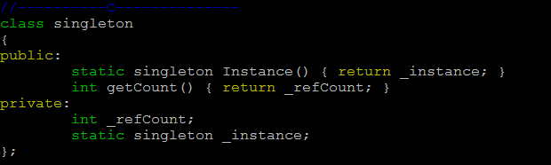
Singleton implementation #C
https://github.com/Morpheusou/TCPL/blob/master/demo/singleton.cpp

Slide 16
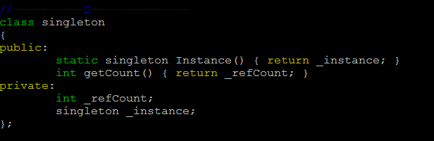
Singleton implementation #D
https://github.com/Morpheusou/TCPL/blob/master/demo/singleton.cpp

Slide 17
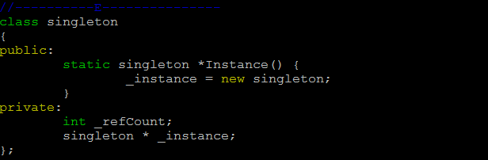
Singleton implementation #E
https://github.com/Morpheusou/TCPL/blob/master/demo/singleton.cpp

Slide 18
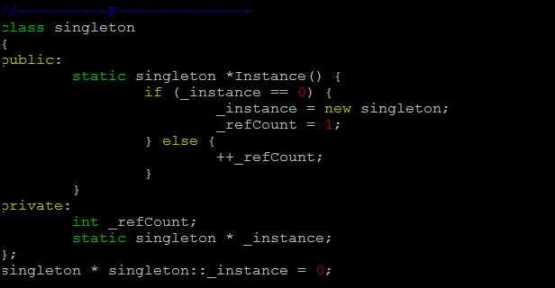
Singleton implementation #F
https://github.com/Morpheusou/TCPL/blob/master/demo/singleton.cpp
Notes:
Inline function within class definition.

Slide 21
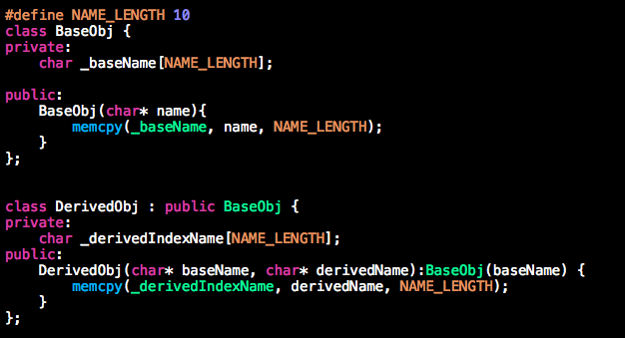
继承

Slide 22
继承 memory view
DerivedPublicObj derived("base", "derived");
&derived 0x7fff5fbff980
&derived._baseName 0x7fff5fbff980
&derived._derivedIndexName 0x7fff5fbff98a

Slide 23
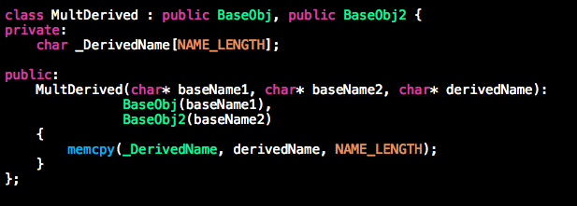
多重继承

Slide 24
多重继承 memory view
MultDerived multderived("base1", "base2", "derived");
Multderived 0x7fff5fbff960
Multderived._baseName 0x7fff5fbff960
Multderived._baseName 0x7fff5fbff96a
Multderived._DerivedName 0x7fff5fbff974

Slide 25
Q&A
Sizeof（）
当继承发生时，怎样计算对象的大小

Slide 26
三种继承关系
public 继承：基类的公有成员成为派生类的公有成员；基类的保护成员成为派生类的保护成员。一个基类的私有成员不能被派生类直接访问，但可以通过调用基类的公有和保护成员访问基类的私有成员。
protected 继承：基类的公有和保护成员成为派生类的保护成员。
private 继承：基类的公有和保护成员成为派生类的私有成员。

Slide 27
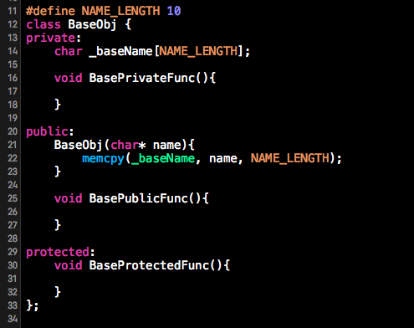
base

Slide 28
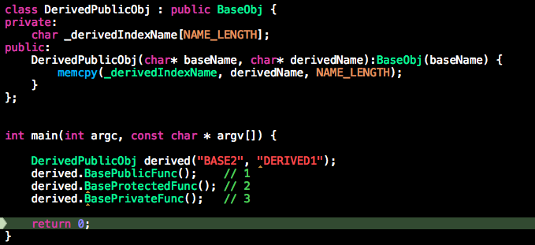
Public 继承

Slide 29
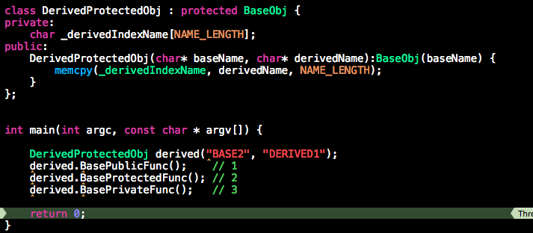
Protected继承

Slide 30
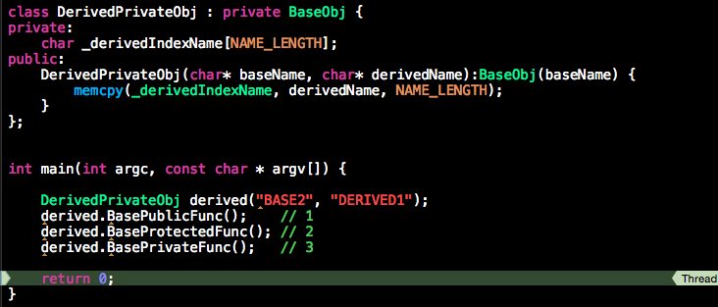
Private 继承

Slide 31
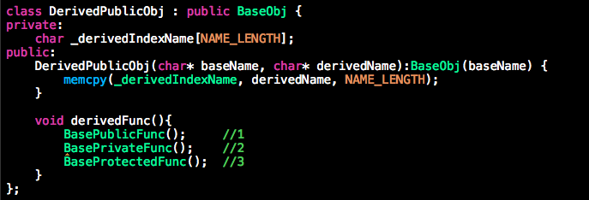
Public 继承子类内

Slide 32
Q&A
Is a & has a
公有继承常被形容为“Is a”，私有继承常被形容为“has a”。请从三种继承类型和类成员的访问控制的角度来解释

Slide 33
继承
扩展阅读
虚继承

Slide 34
多态性
一个接口，多种方法
封装可以使得代码模块化，继承可以扩展已存在的代码，他们的目的都是为了代码重用。而多态的目的则是为了接口重用。

Slide 35
C++ 动态多态
方法是虚函数
调用时使用指针或是引用

Slide 36
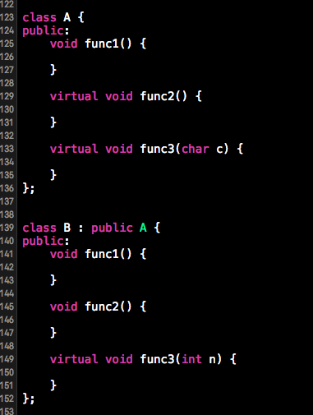

Slide 37
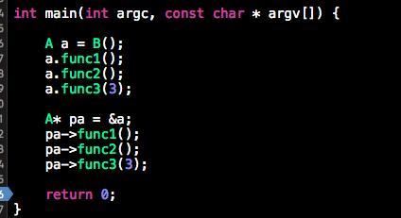

Slide 38
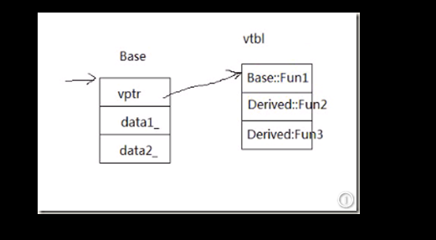
多态 实现

Slide 39
Q&A
设计一个可以储存所有类型的数组
Class shape
Class triangle , round, quadrangle
每一个类都有一个方法用来输出面积area
用一个循环输出它们

Slide 40
多态 扩展阅读
纯虚函数

Slide 41
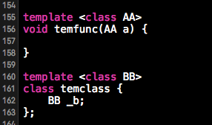
模板

Slide 42
模板
模板可以实现类型的参数化(把类型定义为参数)，从而实现了真正的代码可重用性。

Slide 43
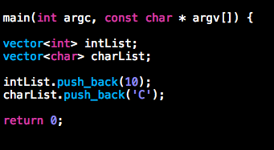
STL

Slide 44
Q&A
使用vector存储shape对象
Class shape
Class triangle , round, quadrangle
每一个类都有一个方法用来输出面积area
用一个循环输出它们

Slide 45
模板 扩展阅读
STL 算法
函数对象

